Slide 1
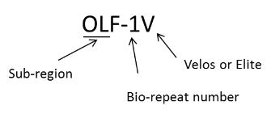
Pearson correlation coefficient (R)
Supplement Fig. 2. Repeatability of mass spectrometry analysis of each mouse brain regions

